Slide 1
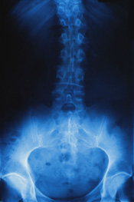
Osteoporosis
By Emil Bladt - Woicek

Slide 2
Causes of Osteoporosis
Osteoporosis is a disorder where the bones become weak and break under no pressure. This disease happens when there isn't enough minerals, such as calcium in the bones to keep them healthy.
The bones take the minerals away faster than the body can replace them. This causes the bones to become weaker and more fragile. With osteoporosis, just the slightest bump can cause serious fractures to the bones.
The most common places to get osteoporosis is in the hip, wrist, spine, the pelvis and the upper arms.

Slide 3
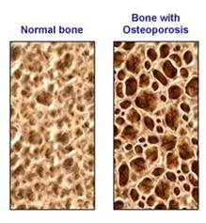
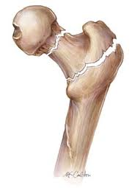
Symptoms of Osteoporosis.
Osteoporosis is a silent disease, meaning you usually don't know you have it until you break something. There aren’t many signs and symptoms of osteoporosis, one symptom is easily breaking bones.

Slide 4
Who is more prone?
Both men and women get osteoporosis but women are more at risk. Women get osteoporosis more because their oestrogen levels decrease more rapidly after their menopause.
Oestrogen is such an important hormone, it helps maintaining a healthy bones structure.

Slide 5
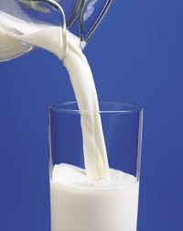
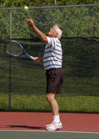
How to prevent osteoporosis
Preventing osteoporosis is quite simple. You need to maintain a high calcium level in your body, which you do by frequently drinking milk or dairy products.
You also need Vitamin D which comes from the sun. Keeping you levels up Vitamin D up can be as simple as taking a leisurely walk on the beach or just being outside to drink your cup of morning coffee.
The third thing that helps prevent osteoporosis is exercise. Playing tennis, lawn bowls, walking and any other sorts of exercise with help you to keep your body healthy.

Slide 6
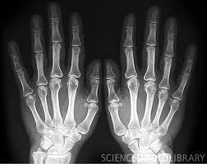
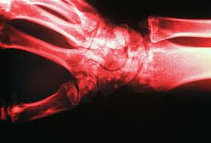
Osteoporosis support networks.
The Osteoporosis Sydney Support Group is located St George Hospital, Sydney. Contact the Sydney support group on:1800 242 141
The Melbourne Osteoporosis support group comes together every 3rd Tuesday of every second month at 1:30 pm.

Slide 7
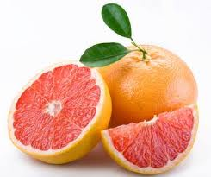
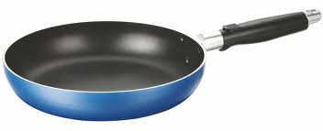
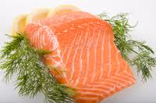
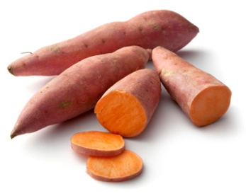
Meal Plan: Day 1
Breakfast: 1 bowl of oatmeal or porridge with some sliced strawberries on top. To accompany the porridge you should drink a large glass of calcium fortified orange juice to increase your calcium levels.
Great cooking tips:
For the salmon, try to avoid using large amounts of butter. Keep the skin of the salmon on when cooking it and just remove the skin before eating.
Use a non stick frying pan, this helps the fish not stick to the pan and it is easier to move the fish around.
Afternoon snack: For a light snack in the afternoon you should have some fresh or dried fruit. Good fruits for people with osteoporosis are pink grape fruits and red grapes. You should also have some sort of nuts, peanuts, walnuts and almonds will keep you satisfied until dinner.
Dinner: Dinner consists of a salmon fillet, green vegetables including broccoli and zucchini, and some sweet potato. On the salmon there is some pesto which is a nice accompaniment.
Lunch: For lunch, a nice fresh salad with cooked pumpkin, sweet potato, broccoli, lightly steamed carrots and squash.

Slide 8
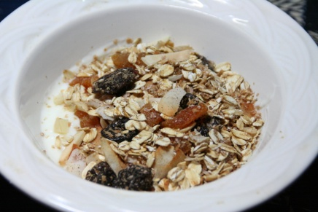
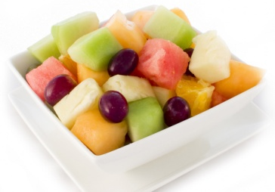
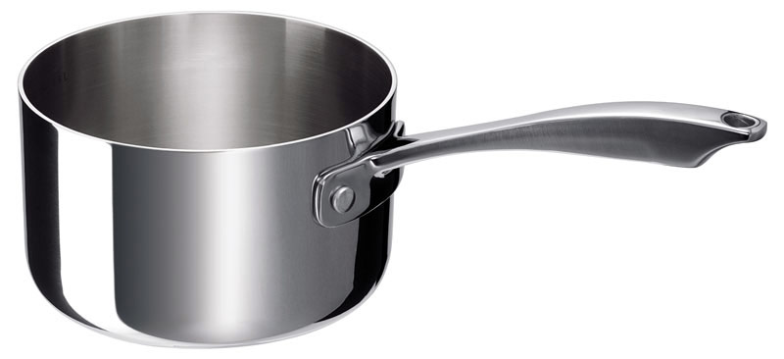
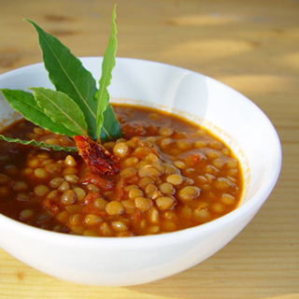
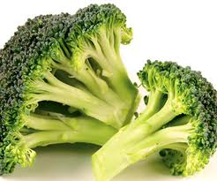
Meal Plan: Day 2
Breakfast: A bowl of muesli with yogurt. The muesli should contain dried fruits such as apricots, raisins and some nuts like almonds and walnuts. Red grapes and a large glass of calcium fortified orange juice to finish breakfast off.
Afternoon Snack: Afternoon tea is a fruit salad which contains apples, pears, oranges, mango, peaches, rock melon and red grapes. This is a great healthy snack and gets you ready for dinner.
Great Cooking Tips
The lentil soup should be cooked in a large saucepan over medium heat until hot. You either buy your lentil soup or make it yourself.
Lunch: Lunch consists of a substantial bowl of lentil soup. To accompany the soup, have some sliced bread.
Dinner: It is a pasta dish with some boneless chicken and tomato sauce. In the sauce there is minced garlic, broccoli and chopped spinach.

Slide 9
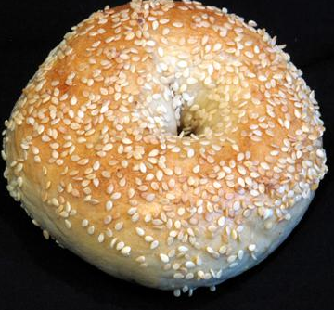
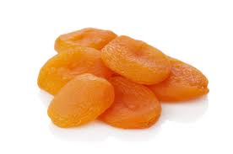
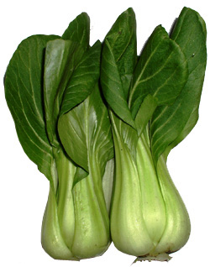
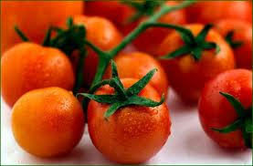
Meal Plan: Day 3
Breakfast: A sesame seed bagel with fat reduced cream cheese. Some red grapes and a segmented orange.
Afternoon snack: A small handful of walnuts and pecans. With some dried apricots and dried figs
Dinner: A tofu stir fry cooked in a non stick frying pan. In the stir fry there is Bok Choy, broccoli florets, tofu, green beans, carrots and red capsicum. For the dressing drizzle some salt reduced soy sauce.
Lunch: A large green salad, with sliced chicken, cos lettuce, red capsicum, fresh peas and cherry tomatoes.

